Slide 1


Notes:
Greetings,
My name is João Ralha, and I'm here to present our work accepted to the 1st EAGE Conference on ML in LA
The title of our paper is "Deep Learning with Generative Models Applied to Tomography Texture Inference“ and in the next few minutes I’ll try to give an overview of the challenges we faced, and the breakthroughs achieved.

Slide 2


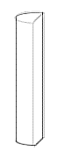
Deep Learning with Generative Models Applied to
Tomography Texture Inference
1. Introduction
Considering a high definition photo and a tomographic scan of the same well core, can we infer information about one based on the other?
DSLR Camera
Compositing
HD Photos – 2D Texture and Color Data
X-Ray Machine
Tomographic Scan – 3D Density (Grayscale) Data
Well Core
Physical Sample
Notes:
So first things first, what is the motivation behind this work?
Our motivation is to try to infer the texture and color information from visible light capture in HD core photos to tomographic scans in order to build lifelike digital 3D models of well cores.
Tomographies already allow for the building of 3D models, but since tomographies only capture density data, which is single channel and, consequentially, grayscale, these models are also grayscale.
Our methodology attempts to use the information available in HD photos to introduce texture and color information to these 3D models.
The diagram at the bottom of the slide represents the workflow for data acquisition. After we had access to the well cores, we both photograph and scan them with an X-Ray machine to obtain our datasets.

Slide 3
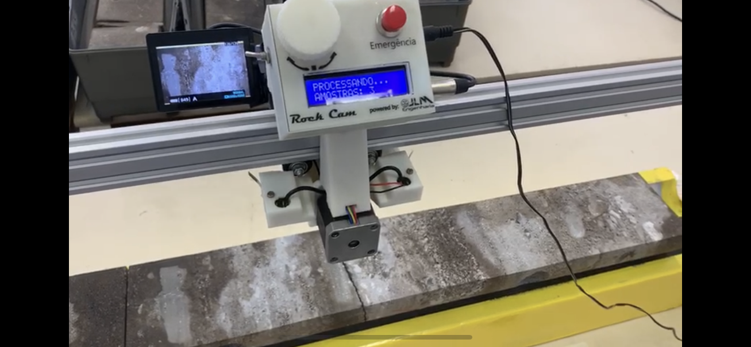
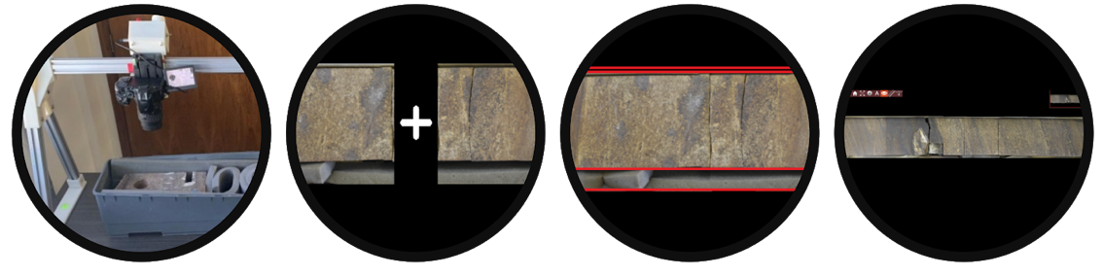
Deep Learning with Generative Models Applied to
Tomography Texture Inference
Image Compositing
By using multiple HD photos and compositing them together it’s possible to construct a high definition panorama spanning the entire core sample.
This study uses samples acquired using RockCare’s proprietary RockCam technology to generate the HD panoramas.
Image acquisition by the RockCam automatic core imaging tool. Workflow from image acquisition from compositing into HD panoramas

Slide 4
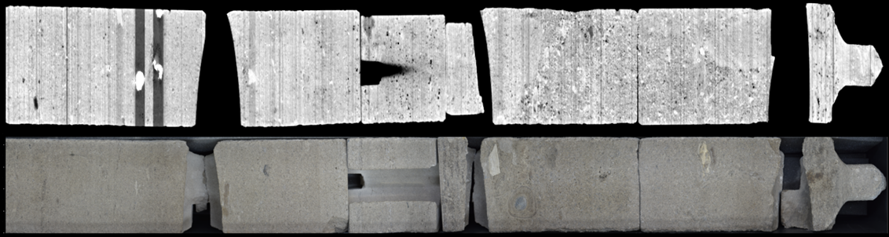
Deep Learning with Generative Models Applied to
Tomography Texture Inference
Image Compositing
By using multiple HD photos and compositing them together it’s possible to construct a high definition panorama spanning the entire core sample.
This study uses samples acquired using RockCare’s proprietary RockCam technology to generate the HD panoramas.
HD Panorama and an approximately matching slice in the 3D tomographic volume

Slide 5
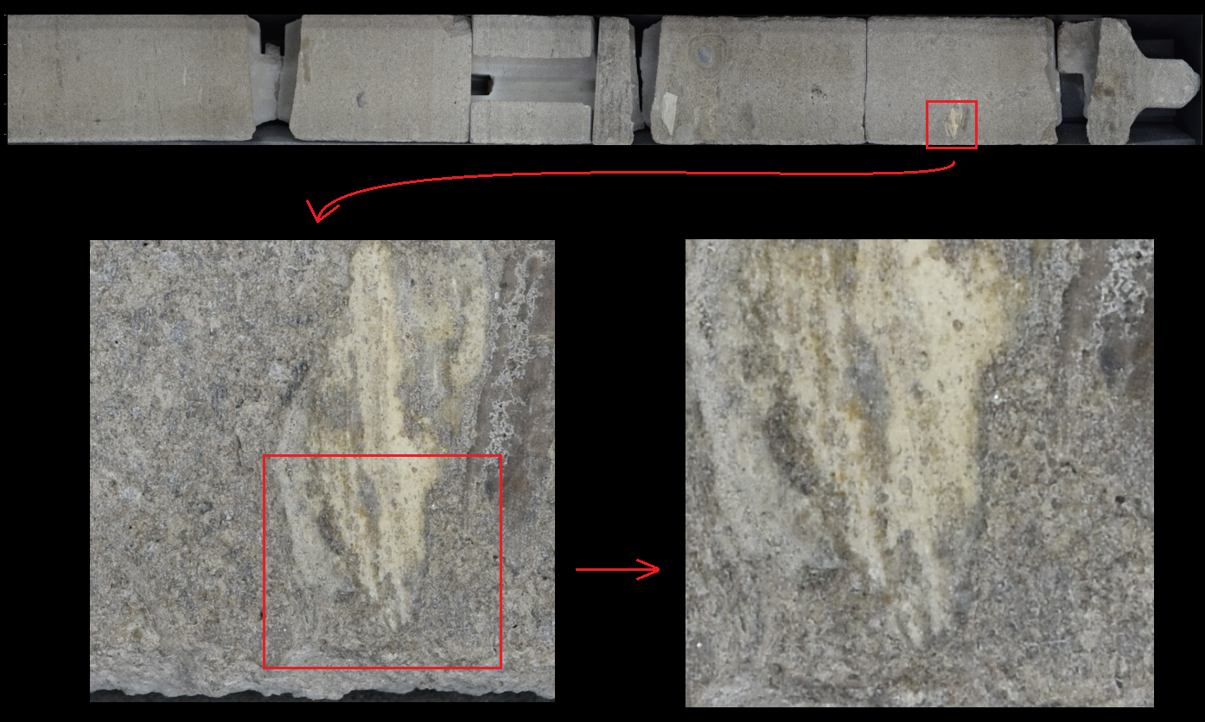
Deep Learning with Generative Models Applied to
Tomography Texture Inference
Image Compositing
Example of the resolution of the HD panoramas

Slide 6
Deep Learning with Generative Models Applied to
Tomography Texture Inference
Regression Approaches
The naive solution would be to train a regression model to estimate the RGB values individually.
Requires pixels in each image to match perfectly.
As we can see below, there is no way to ensure that.

Slide 7
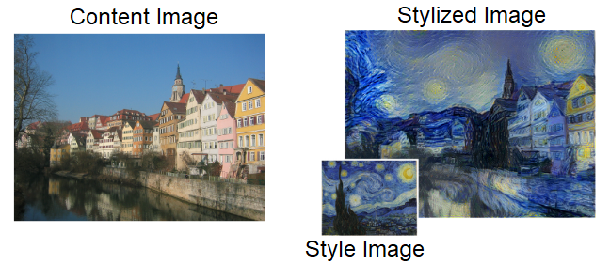
Deep Learning with Generative Models Applied to
Tomography Texture Inference
Neural Style Transfer
Computational vision technique where a convolutional neural network applies the style (texture) of one image to another image.
Example of neural style transfer applying the style of Van Gogh’s Starry Night to the content image.
Modified from Gatys et al., 2015

Slide 8
Deep Learning with Generative Models Applied to
Tomography Texture Inference
Neural Style Transfer
Limitations:
Computationally expensive as no model is trained, each content image is individually optimized.
Limited to a single style image.
Example of neural style transfer applying the style of Van Gogh’s Starry Night to the content image.
Modified from Gatys et al., 2015

Slide 9
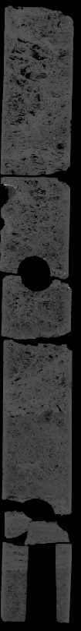
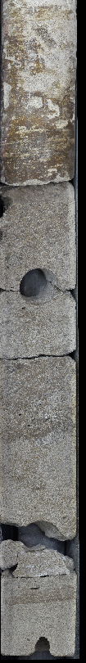
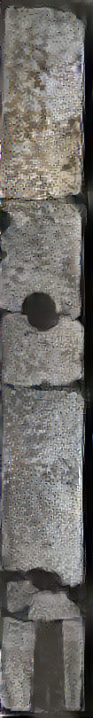
Deep Learning with Generative Models Applied to
Tomography Texture Inference
Neural Style Transfer
Tomographic Scan
HD Panorama
Stylized
Tomography
Results obtained with Style Transfer, outputs are generally low-resolution and applying the style to all slices of a tomographic volume isn’t viable.

Slide 10
Deep Learning with Generative Models Applied to
Tomography Texture Inference
Generative Adversarial Networks (GANs)
GANs consist of two separate Convolutional Neural Networks (CNNs), the generator and the discriminator.
The generator attempts to generate samples based on the distribution of the training data.
The discriminator classifies a given sample as real or fake.
The generator is trained to fool the discriminator, while the discriminator is trained to reduce errors in its classification.
GANs are powerful tools for image generation, being infamously used in “Deep Fakes” videos.
Error Backpropagation
Real Images
Discriminator
Real / Fake
Classification
Fake Image
Random Variable
Generator
Error Backpropagation

Slide 11
Deep Learning with Generative Models Applied to
Tomography Texture Inference
Cycle-Consistent Adversarial Networks (CycleGANs)
Consist of two separate GANs trained together.
Unpaired image domain translation.
Once a model is trained, applying to new images is relatively simple.
Error Backpropagation
Real Images
A
Generator
B
Fake Images
B
Generator
A
Reconstructed Images
A
Error Backpropagation
Real / Fake
Classification
Discriminator B
Domain A – Tomographic Scans
Domain B – HD Photos
Real Images
B

Slide 12
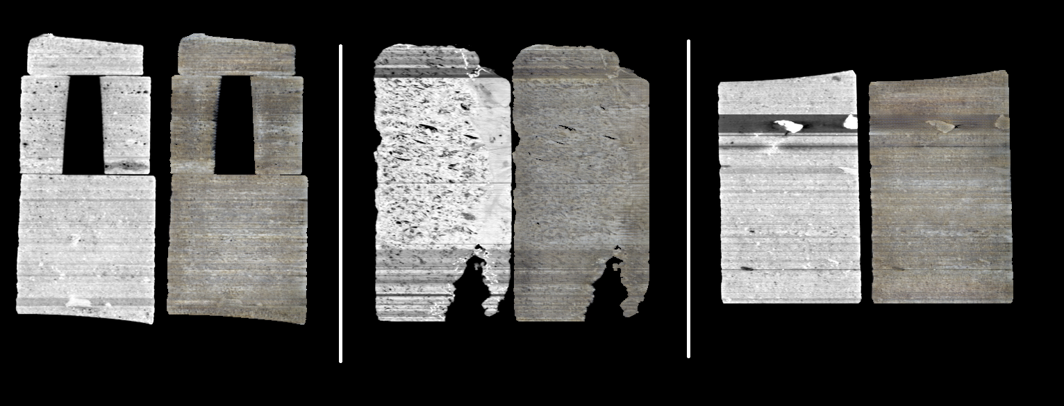
Deep Learning with Generative Models Applied to
Tomography Texture Inference
Cycle-Consistent Adversarial Networks (CycleGANs)
Results:
Higher resolution and more realistic looking textures applied to the tomographic scans.

Slide 13
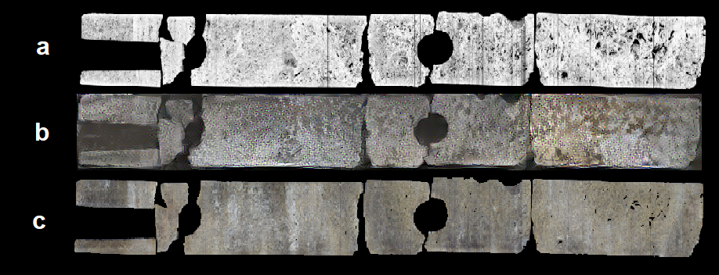
Deep Learning with Generative Models Applied to
Tomography Texture Inference
Cycle-Consistent Adversarial Networks (CycleGANs)
Results:
Comparison of results on the same tomographic scan slice (a) between Style Transfer (b) and CycleGAN (c)

Slide 14
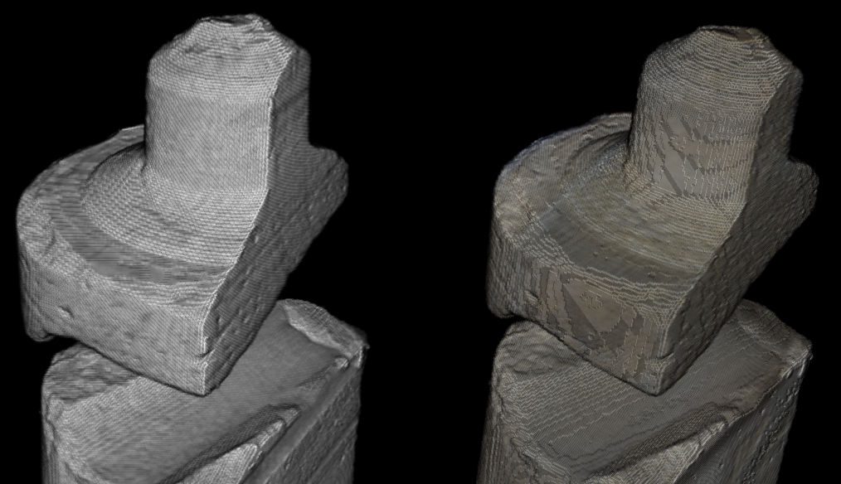
Deep Learning with Generative Models Applied to
Tomography Texture Inference
Cycle-Consistent Adversarial Networks (CycleGANs)
Results:
Stacking of Slices allows us to build volumes, using the CycleGan results allows for a color volume.

Slide 15

Deep Learning with Generative Models Applied to
Tomography Texture Inference

